Slide 1

TUGAS AKHIR
“Parallelizing CNN and Transformer Encoders for Audio Based Emotion Recognition in English Language”
05111942000001
Adam Satria Adidarma
Kelly Rossa Sungkono – Shintami Chusnul Hidayati

Slide 2
Outline
Introduction
Problem Statement
Architecture Design
Methodology
Results
Conclusion

Slide 3



Introduction
AI has had a significant impact on various industries and sectors of society around the world, with the adoption of AI growing from 2018 - 2019
SER is a subfield of AI with the task of recognizing emotional aspects of speech independently over the semantic content
+
=
Notes:
- AI adoption has grown by 37% in 2018-2019 according to an article by Gartner Report.
- Speech emotion recognition (SER) is the task of recognizing the emotional aspects of speech independently over the semantic content and is one of the emerging applications in the context of Artificial Intelligence (AI). SER is an important task in human-computer interaction because emotion play a big role in human communication, which can be used for various applications such as personalized advertising, mental health monitoring, and speech therapy.
This study explored a parallelized approach to emotion recognition using Convolutional Neural Networks (CNN) and Transformer encoders for audio-based emotion recognition in the English language.

Slide 4
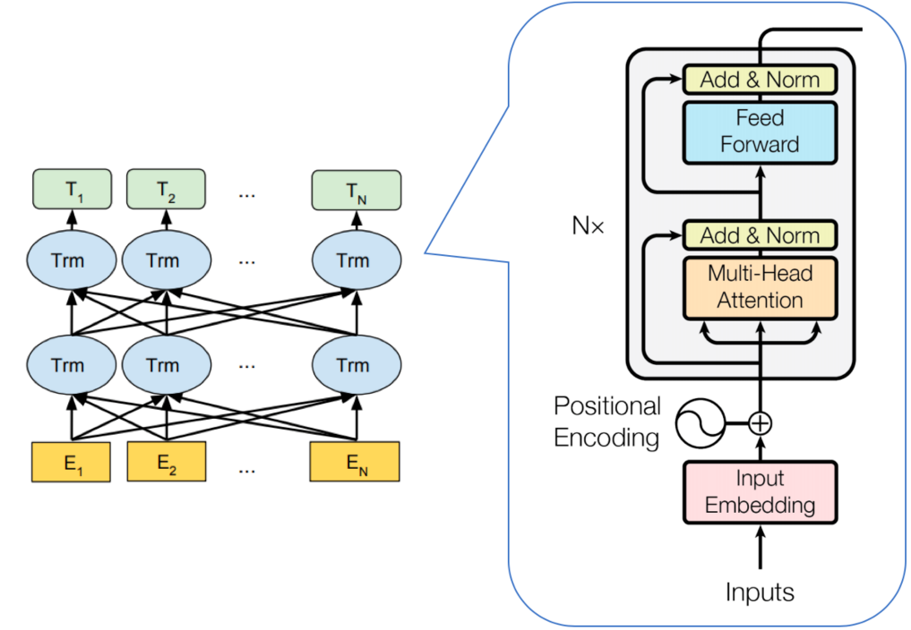
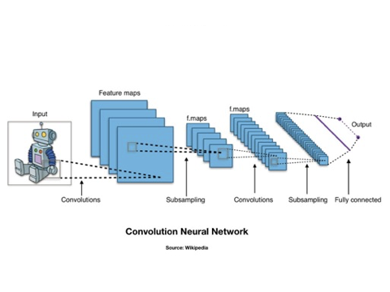
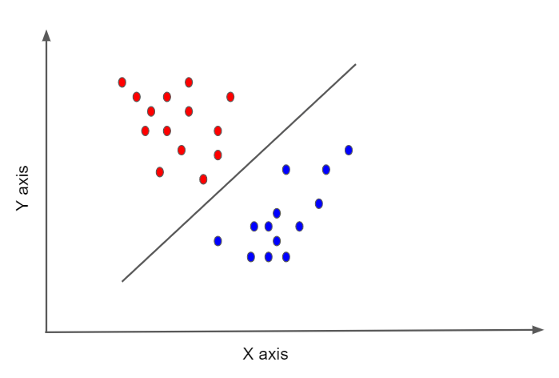
Background
Emotion Recognition History
Transformer-Based
SVM
CNN-Based
Notes:
- Emotion recognition has traditionally been performed using handcrafted features and machine learning algorithms such as SVM. However, these methods are limited by their reliance on domain expertise and lack of generalization.
- Recent advances in deep learning-based Convolutional Neural Network (CNN) have shown promising results outperforming traditional handcrafted feature-based methods in image classification.
- In the field of NLP, state of the art deep architecture such as GPT-3 and BERT are emerging to solve sequential learning problems based on the self-attention mechanism in the Transformer Network, making them suitable for emotion recognition tasks.

Slide 5
Problem Statement
How to combine the Transformer Encoder and CNN to detect human emotions from audio data?
How to optimize the accuracy of the model architecture?
Which classification methods are more accurate between SVM, LeNet-based CNN, CRNN, and Parallel Transformer Encoder with CNN for audio-based emotion detection?

Slide 6
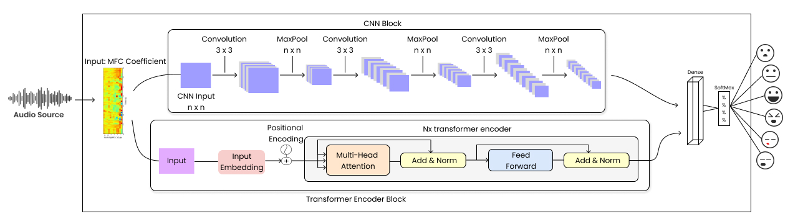
Architecture Design
Emotion
Notes:
The idea is for the CNN block to give a feature representation on the audio data, while the transformer encoder block learns to predict frequency distributions of different emotions by considering the overall structure of the MFCC plot for each emotion

Slide 7
Designed Method
A combination of Transformer Encoder block and CNN-based architecture with a series of convolutional and pooling layers. These blocks are combined with a dense layer, and the resulting output is passed to a softmax activation function to convert prediction scores into a probability distribution of target class.
Notes:
A combination of Transformer Encoder consisting of self-attention layers, followed by a feedforward layer that consisted of two linear transformations with a ReLU activation in between and CNN-based architecture with a 3x3 convolution layer followed by an ELU activation function, batch normalization, pooling layers, and dropout regulation. These blocks are combined with a dense layer, and the resulting output is passed to a softmax activation function to convert prediction scores into a probability distribution of target class.

Slide 8
Methodology
1.
Pre-Processing
2.
Feature Extraction
Transforming raw audio signals into a format that is suitable for machine learning algorithms to extract meaningful information.
Extract spectral characteristics of sound by transforming the audio waveform into a compact representation with MFCC.
3.
Build Model
Construct predictive model using the processed data and extracted features, find appropriate algorithm, training the model on the data, and evaluating its performance.
Notes:
In the context of audio emotion recognition, this involves a series of steps, including downsampling the audio to a custom target sample rate, truncating the audio to a set number of duration, and removing any silence before the actors start talking. These steps help to ensure consistency in the audio data and remove any irrelevant noise or silence that may affect the accuracy of the emotion recognition model.
MFCC are derived from a Mel-scale, which is a non-linear scale based on the perceived freq of a sound by the human ear.
After the audio features have been extracted, the next step is to create the model architecture and use the extracted features as input to the model which will allow the model to classify human emotions based on the extracted features.

Slide 9
Dataset
1.
CREMA-D
2.
RAVDESS
The dataset contains 7,442 clips of audio and video recordings of various everyday scenarios, such as people talking, laughing, and singing in various environments.
The dataset works with balanced representation of male and female voices consisting of 1,470 recordings from professional actors and actresses.
3.
SAVEE
Dataset features 4 male actors expressing different emotions with a spoken British English accent that contains a total of 480 audio recordings.
Notes:
Two types of audio data records, lab recording & non-lab recording.
Lab recording: recorded in a recording studio using high-quality microphones and accompanied by linguistics experts.
Non-lab recording: Contains uterances that reflect emotions involuntarily in natural scenarios.

Slide 10
Model Evaluation
1.
Train-Validation Curve
2.
Confusion Matrix
Visual representation of model performance during training, showing the progression of the loss and accuracy for both the training and validation sets over epochs or iterations.
Provides overall measure of model performance by measuring the proportion of correctly predicted instances out of the total number of instances.
3.
Accuracy
Summarizes the performance of a classification model by displaying the counts of true positive, true negative, false positive, and false negative predictions.
Notes:
- Tracking the training process of a model could help identify and address the overfitting and underfitting in the data, also determine whether the model has converged or if it requires additional training iterations.
- Conf Matrix: provides insights into the model's ability to correctly classify different classes and helps assess its performance in terms of precision (row), recall (column), and F1 score (balanced representation of precision & recall).
- Accuracy measures the overall performance of a model by dividing the number of correct predictions by the total number of predictions, it is often misleading for imbalanced dataset scenario.

Slide 11
Results
Accuracy & Loss Curve
Confusion Matrix
Model Comparisons

Slide 12
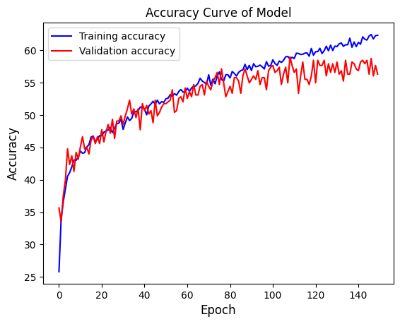
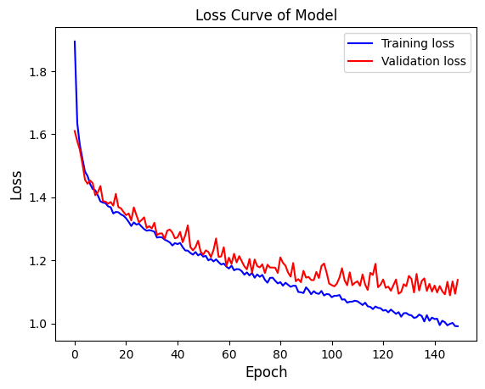
Accuracy & Loss Curve (CREMA-D)
Notes:
Accuracy trend: At the beginning of training, the accuracy was relatively low, which is expected as the model started with random weights and made initial predictions. However, as training progressed, the accuracy consistently increased, indicating that the model was effectively learning from the data.
Loss trend: Initially, the loss was relatively high, indicating that the model's predictions were far from the true labels. However, as the training advanced, the loss steadily decreased. This demonstrates that the model was progressively aligning its predictions with the true labels, indicating improved performance and convergence towards an optimal solution.
Convergence: The number of epochs required for the model to converge and start overfitting the training data varied across these datasets. The model trained on the CREMA-D dataset achieved the highest accuracy of 59%, stopping at epoch 145. Stopping the training at the convergence point helps prevent overfitting and ensure the model generalizes well to unseen data.
Fluctuation: Throughout the training process, dips in the graphs could indicate model instability, start overfitting, and random variability.

Slide 13
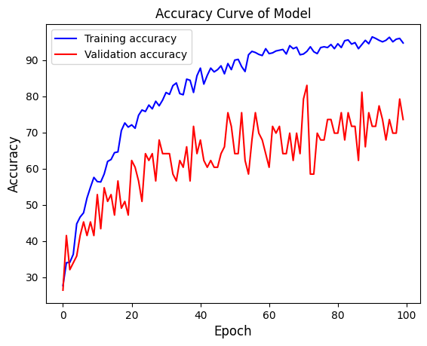
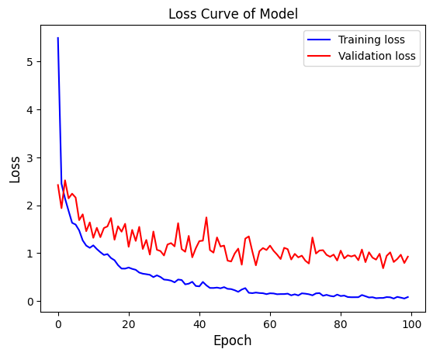
Accuracy & Loss Curve (RAVDESS)
Notes:
Accuracy trend: Explain how the accuracy metric reflects the model's ability to correctly classify emotions in the audio data.
Loss trend: Explain that loss is a measure of how well the model is fitting the training data. A decreasing loss indicates that the model is learning and converging towards optimal performance.
Convergence: The model trained on the RAVDESS dataset achieved a peak accuracy of 79% and converged faster than CREMA-D, stopping at epoch 100.
Fluctuation: A lot of fluctuation happens during this training process, which could indicate that the learning rate used for updating the model's weights was too high, this could cause the model to overshoot the optimal weights and hinder its convergence.

Slide 14
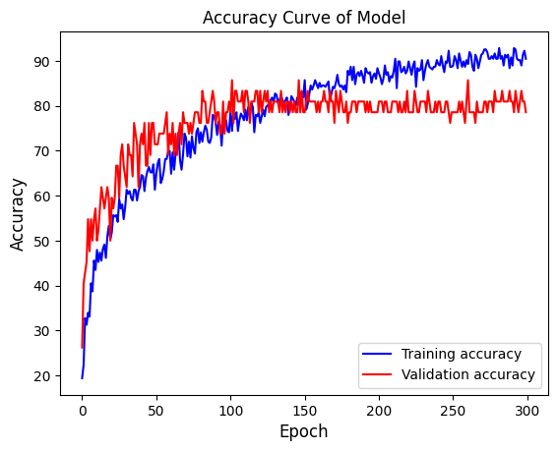
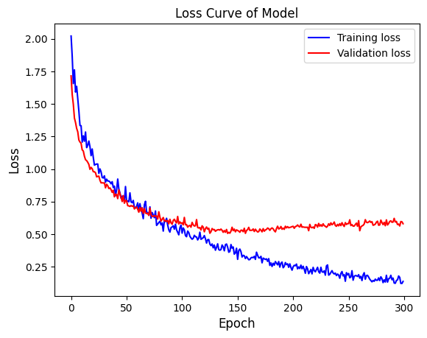
Accuracy & Loss Curve (SAVEE)
Notes:
For this dataset, a lower learning rate was set to avoid overshooting the optimal solution and to achieve a more stable training process, which resulted in a longer training time, with the model stopping at epoch 300 and achieving a maximum accuracy of 83%.
The validation loss curve showed increasing trend near the end indicating early overfitting. As the training continued, the model becomes too specialized to the training data and fails to generalize well to new, unseen data

Slide 15
Confusion Matrix
Emotion Labels
Angry, Fear, Disgust, Happy, Neutral, and Sad
Datasets
CREMA-D, RAVDESS, and SAVEE
Performance Metrics
Additional metrics can be derived from the confusion matrix such as, precision, recall, and F1-score

Slide 16
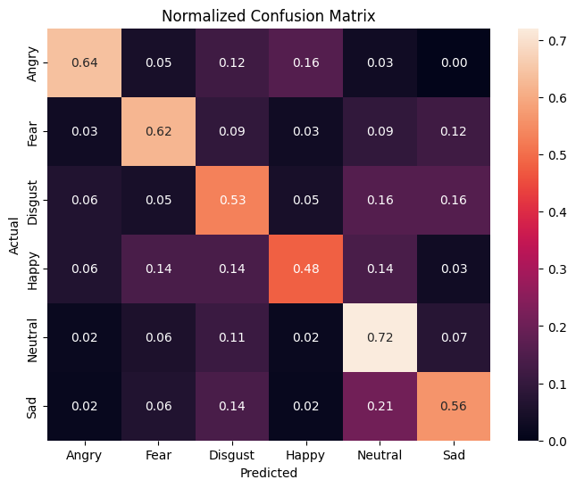
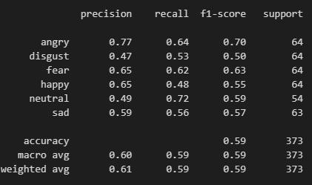
Model Performance (CREMA-D)
Notes:
The results showed that the model had different levels of confusion across the different datasets:
Column is model prediction, row is ground truth
Neutral highest TP, Happy lowest TP. This is because a lot of misclassification distributed across emotions.
High level of confusion between sad and neutral emotion.
Angry emotion highest f1-score due to its high precision score.

Slide 17
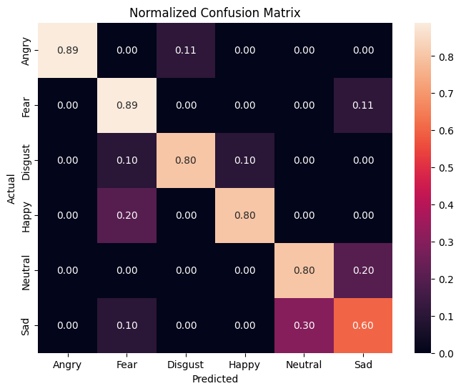
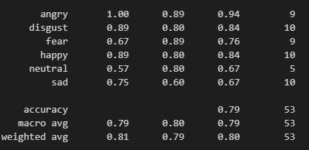
Model Performance (RAVDESS)
Notes:
Angry & Fear highest TP, Sad lowest TP. High confusion between sad and neutral emotions again.
Angry has the highest f1-score due to its high precision score compared to fear which is the close second.
Angry achieved perfect score in precision, meaning the model didn’t falsely classify this emotion into any other category.

Slide 18
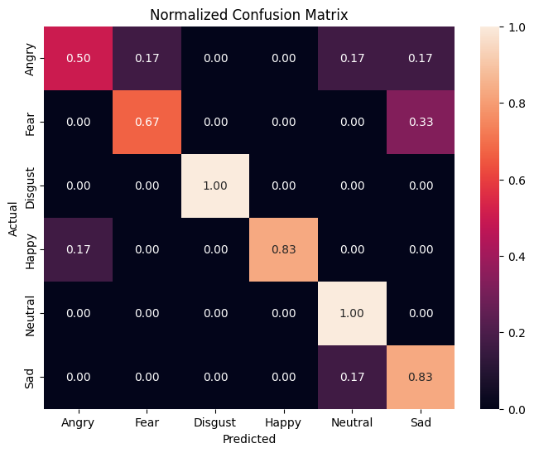
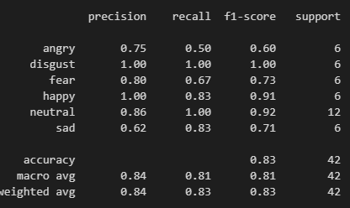
Model Performance (SAVEE)
Notes:
Angry lowest TP, Disgust & Neutral highest TP. Angry is misclassified across fear, neutral, and sad.
Fear and Sad had a high level of confusion between each other.
Disgust had the highest f1-score due to its high precision and recall scores in the predictions and Angry have the lowest score for this dataset.

Slide 19
Model Comparisons

Slide 20
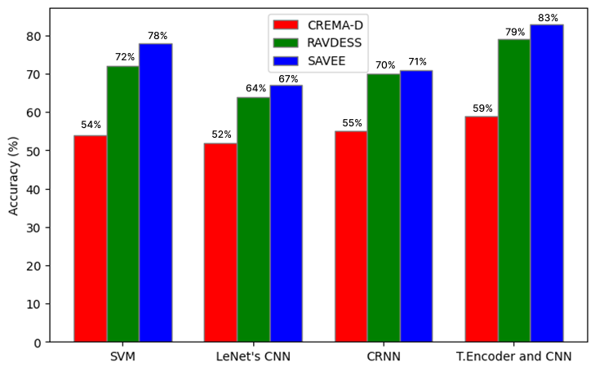
Model Comparisons
Model | Average Accuracy
SVM | 68%
LeNet CNN | 61%
CRNN | 65%
Transformer Encoder and CNN | 74%
Notes:
The models being compared include SVM, LeNet CNN, CRNN, and the Parallel Transformer Encoder with CNN Architecture. This section highlight the model with the highest accuracy among all the models compared.

Slide 21
Conclusion
The study addressed the problem of detecting human emotions from audio data by integrating the Transformer Encoder and CNN architectures to capture global dependencies and local patterns in audio features.
Optimization techniques include fine-tuning hyperparameters and applying regularization methods, further enhanced accuracy.
Comparative analysis on different models revealed that the Parallel Transformer Encoder with CNN Architecture achieved the highest accuracy, followed by the SVM model.
Notes:
To combine the Transformer Encoder and CNN for detecting human emotions from audio data, the study utilized a model architecture that included one block of Transformer Encoder with self-attention layers, followed by a feedforward layer. Additionally, two blocks resembling the CNN-based architecture of LeNet were employed, consisting of a 3×3 convolution layer, an ELU activation function, batch normalization, and a pooling layer for downsampling the feature maps. The output tensors of these blocks were combined using a dense layer, and the SoftMax activation function was applied to convert prediction scores into a probability distribution over the emotional states in the dataset.
Optimization techniques include fine-tuning hyperparameters (such as the learning rate, batch size, and number of layers in the model) and applying regularization methods (such as dropout or weight decay), further enhancing accuracy.
Comparative analysis with SVM, LeNet-based CNN, and CRNN models revealed that the Parallel Transformer Encoder with CNN Architecture achieved the highest accuracy, followed by the SVM model.

Slide 22
Thank You
Aku CINA PELIT MISKIN

